Slide 1
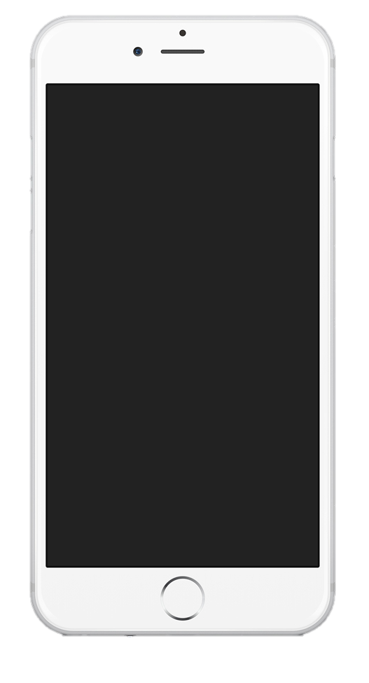
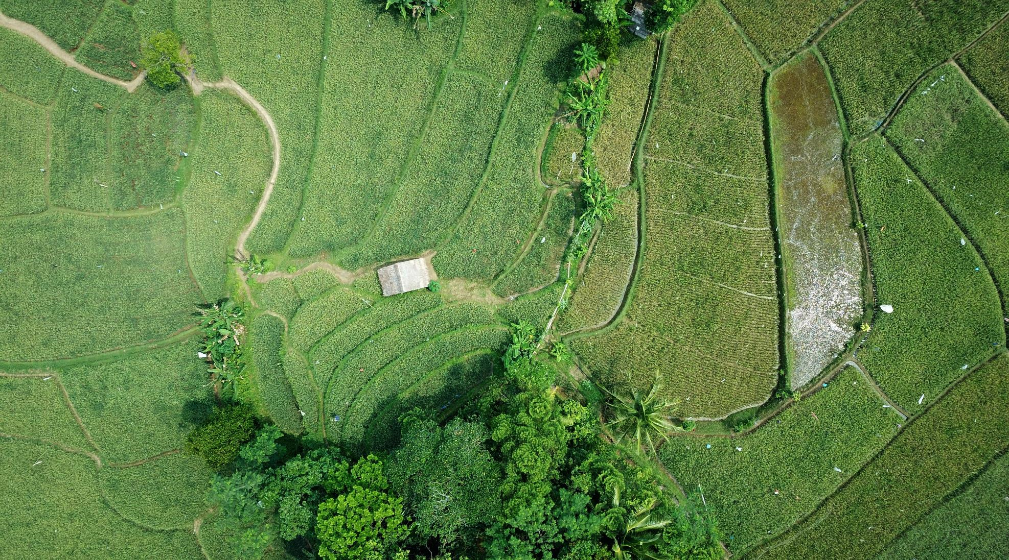
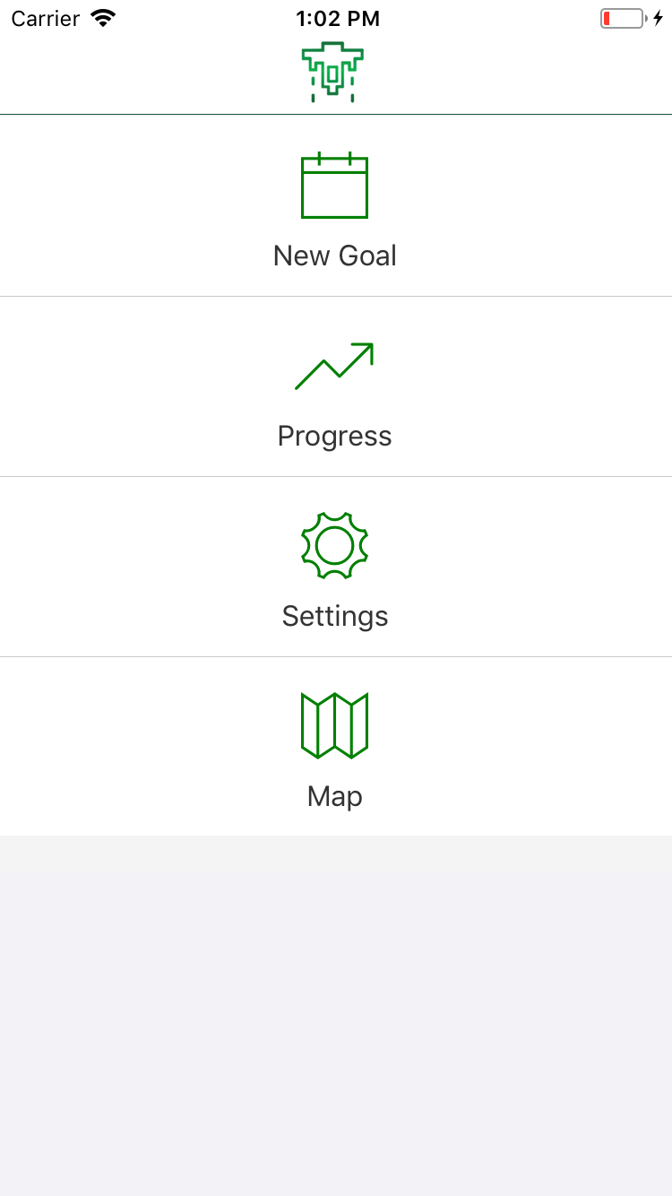

TD MySpend 2.0
Melinda Murzello, Nathan Fischer, Mizanur Rahman, Lily Liu, Ravinder Singh, Jonathan Lam

Slide 2


Market Opportunity
Building
Financial
Security
Growing market of youth and young adults
For the first 3 goals set, customers will receive 1% interest for a max. savings goal of $5,000
Following incentive will be 0.07% interest rate paid at every 25% of the goal reached but compounded monthly
Funds with interest can be withdrawn only after the duration that customer has provided
Our App ties to TD's ready commitment by educating on Financial Security and connecting communities
TD Bank Group

Slide 3
DEMO BEGINS
TD Bank Group

